Slide 1

Predicting Bank Customer Churn
Warren Berg, Drew Brenner, Chris Fernandes

Slide 2

Project Overview
What is Customer Churn?
Objective
Data Set, Features, Target Variable
Models
Predictions

Slide 3
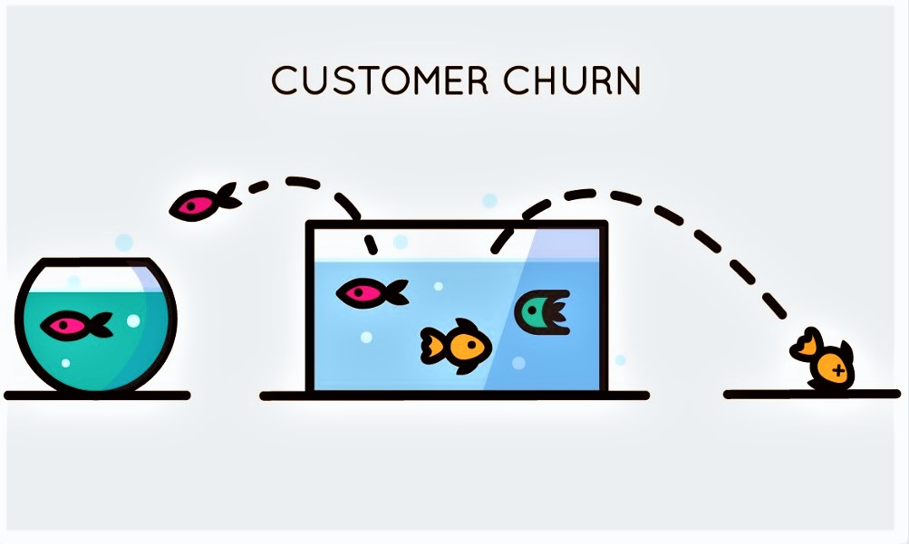
The Problem
Bank customer churn is too high and customers are frequently closing their accounts and switching to different banks.

Slide 4

Objective
Purpose
Create an effective model to accurately predict and target which customers are most likely to exit their bank account
Identify potential customers that are risky before admitting them to the bank
Incentivize customers to continue their business with the bank

Slide 5
Data Set and Features
Features
Customer ID | Tenure
Name | Balance
Credit Score | Number of Accounts
Geography | Credit Card
Gender | Active Member
Age | Estimated Salary
10,000 rows by 13 columns
No missing values
12 Features
Notes:
Chris -
These are the features that had a more significant effect on whether or not customers exited the bank.

Slide 6
Target Variable
‘Exited’ (binary variable)
1 represents a customer leaving within 6 months
0 represents customer stayed with bank

Slide 7
Feature Importance

Slide 8
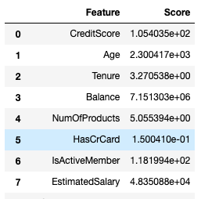
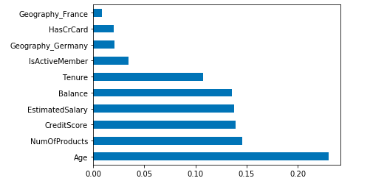
Feature Selection
SelectKBest with chi2 as the score function
ExtraTreesClassifier
Notes:
Because our preliminary tests that we ran suggested overfitting, we decided that we wanted to only use the most important features in ou model. To select these features, we used to methods. SelectKBest whi chi2 as the score function and the ExtraTreesClassifier (De-correlated Trees in a forest). You can see the results for each method on the slide. We decided to move forward with the six most important features that the ExtraTreesClassifier provided: Age, Number of Products, Credit Score, Estimated Salary, Balance, and Tenure. One thing that I should mention is that the HasCreditCard feature was disregarded because it is actually an independent variable.

Slide 9
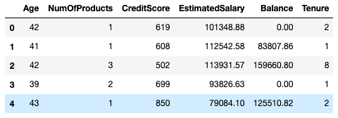
Refined Data Set
Notes:
This is our refined dataset using the top 6 features from the ExtraTreesClassifier.

Slide 10
Model Results

Slide 11




kNN Classification Scores
Before
After
Notes:
After refining our dataset, our scores improved substantially. Before our KNeighborsClassifier model was overfitting whereas after using the new features our model was more generalized.

Slide 12
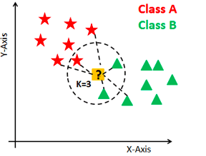
kNN Classification
Cross-Validation showed us that 3 neighbors was the optimal amount.
Notes:
Cross-validation indiciated that three neighbors was the optimal amount.

Slide 13
Logistic Regression
Logistic regression remained the same after narrowing dataset.
Train Score: 79.10%
Test Score: 78.80%
We still do not understand why the scores did not change...
Notes:
Logistic Regression is where things go messy for us. The score did not change after narrowing the features down which concerned us. However the model provided scores that were fairly generalized.
Chris -
Model can’t control complexity
Increase model performance

Slide 14
Cross-Validation Using Logistic Regression
C_Range = [.1, .5, 1, 5, 10, 100, 200]
CV = 4
Produced these results:
Average cross validation scores on train set: [0.7901, 0.7901, 0.7901, 0.7901, 0.7901, 0.7901, 0.7901]
Average cross validation scores on test set: [0.7906, 0.7906, 0.7906, 0.7906, 0.7906, 0.7906, 0.7906]
This was not helpful...
Notes:
We performed cross-validation on the logistic regression model using this C_range and 4 folds. The validation curve produced the following average scores. To be honest, we were not really sure why our model was providing such weird results.

Slide 15
Cross-Validation Using Logistic Regression
Due to the problems we encountered with cross-validation, we decided to use the dataset transformed by MinMaxScaler.
We achieved the same results
Notes:
In order to test the model even more, we developed another validation curve with only one different parameter. The parameter we changed was the training vector. Instead of using the normal data, we used the transformed data from the MinMaxScaler. However, this also produced the same results. After tampering with it for hours with no change, we gave up and decided to move on from the logistic regression model. Drew will now talk about the rest of the models.

Slide 16
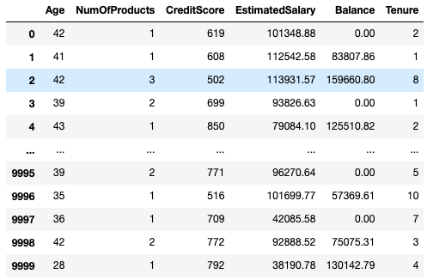

MinMaxScaler
Converting variables to the same scale
Notes:
Transformed our data using MinMaxScaler, so that it was usable for Linear SVC. Given that SVM is sensitive to the scale of variables we wanted to ensure that all variables were on the same scale.

Slide 17






Linear SVC
C=0.1
C=10
C parameter
Train and test scores
Notes:
Max_iter=10,000
LinearSVC is the next model we used in our program. Before getting started on the model, we transformed our data using the MinMaxScaler. Once the data had been transformed, we ran the LinearSVC model with the transformed data and received a train score of 78.33% and a test score of 77.96%. Next, we ran a validation curve for the LinearSVC model and found that the train and test scores decreased slightly with every increase of the C parameter. However, the scores for each set were similar regardless of the C parameter.

Slide 18

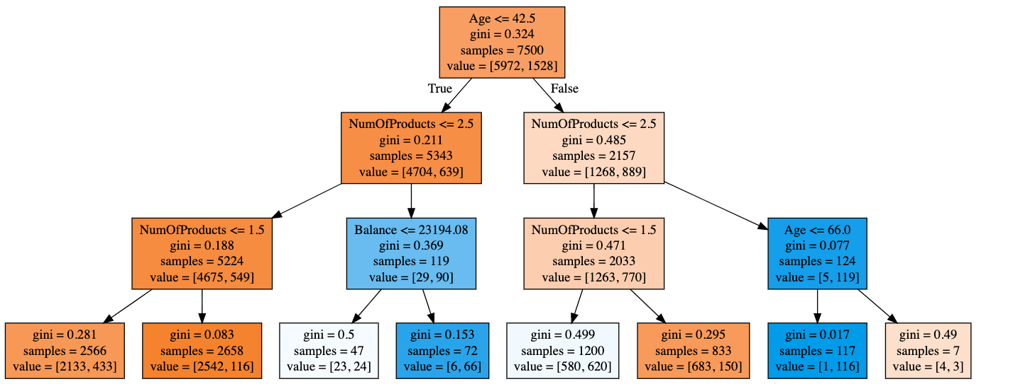
Decision Tree Classifier
Max Depth of 3
Increase in Max Depth
=
Overfitting
Notes:
We were happy with the appearance and performance of the decision tree with a max depth of 3 so we decided to leave it as is. By running a validation curve on the decision tree we confirmed that if we increased the max depth, our model would start to overfit the data.

Slide 19


Random Forest Classifier
N estimators = 500
Random state = 10
Max leaf nodes = 20
Max leaf nodes
Train and test scores
Notes:
After finishing the decision tree we ran a RandomForestClassifier model. We pruned the random forest to have 500 estimators and 20 max-leaf nodes. The model produced a train score of 85.47% and a test score of 83.84%. Like the decision tree, we ran a validation curve with max leaf nodes set as the varying parameter. The train and test scores both increased as the max-leaf nodes increased. However, they got further and further apart per increase showing a trend towards overfitting.

Slide 20
Summary
Model | Train Score | Test Score | Best Parameter
KNeighborsClassifier | 84.20% | 83.56% | n=3
Logistic Regression | 79.10% | 78.80% | Best C was unknown
LinearSVC | 78.33% | 77.90% | C=0.1
RandomTreeClassifier | 82.51% | 82.20% | max_depth=3
RandomForestClassifier | 86.21% | 84.08% | max_leaf_nodes=30
Notes:
Overall summary of all the models we utilized with the best parameter
C=0.1 for LinearSVC was better parameter
Unsure about logistic regression
This is an overall summary of the scores of our models, as you can see we were able to identify the best parameter for each model with the exception of logistic regression. These parameters were the best that we could find, before having to compromise the scores

Slide 21
Predictions
RandomForest: Predicted 80% correctly
kNN Classifier: Predicted 70% correctly
 | Person 1 | Person 2 | Person 3 | Person 4 | Person 5 | Person 6 | Person 7 | Person 8 | Person 9 | Person 10
Actual Data Output | Exit | Stay | Exit | Stay | Stay | Exit | Stay | Exit | Stay | Stay
kNN Classifier Prediction | Stay | Stay | Stay | Stay | Stay | Exit | Stay | Stay | Stay | Stay
Random Forest Prediction | Stay | Stay | Exit | Stay | Stay | Stay | Stay | Exit | Stay | Stay
Notes:
What prediction numbers did we use?
Chose these models given that they had the best train and test scores.
kNN posted 70% percent correctly, so the next set person 11-20 could easily be 8-9/10
Random forest posted 80% correct, slightly better than kNN which is consistent with our data
Chris -
Model can’t control complexity
Increase model performance

Slide 22
Recommendations
Need more observations to build model that performs better with data
Feature engineering
Feature transformation
Feature creation
Remove outliers
Resolve problems with Logistic Regression model to enhance model and utilize for predictions
Notes:
Overall, we were very happy with how our models performed. Our scores could be higher but for now they are efficient enough to be used. Some things that may improve our models are: more data, feature engineering such as transforming the features and creating new features and removing outliers. Additionally, we would like to solve problems with logistic regression before its used.

Slide 23
Thank You!
Notes:
Thank you. Are there any questions?

